Slide 1
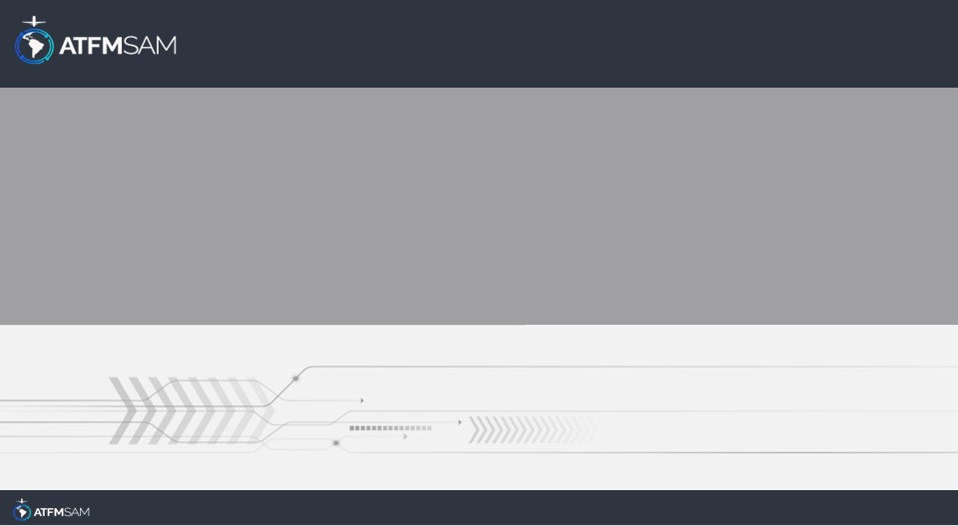
PDA - PERU
12/09/2025

Slide 2
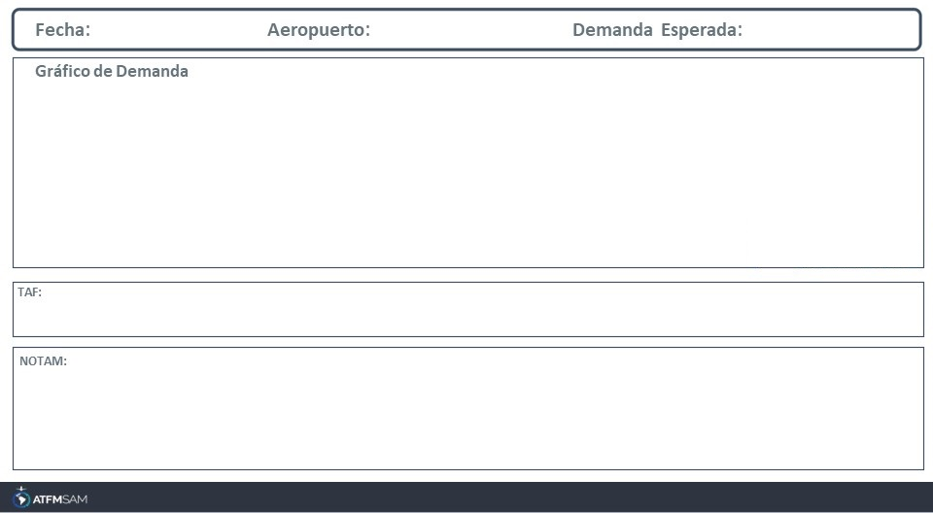
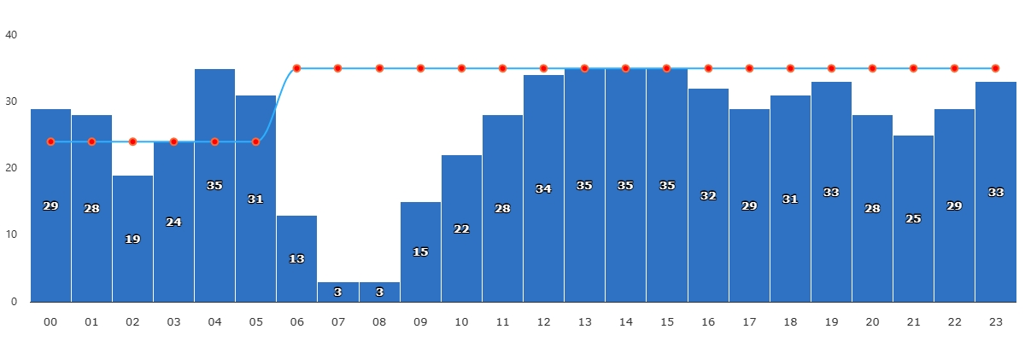
12/09/2025
SPJC
BAJA
VMC
IMC/MET adversa
Majo mínimos / Cerrado
TAF SPJC 111700Z 1118/1218 23010KT 8000 SCT013 OVC022 TX19/1119Z TN15/1211Z BECMG 1200/1203 15004KT FEW007 OVC014 TEMPO 1208/1211 4500 DZ BR SCT005 OVC009 BECMG 1213/1215 23010KT FEW011 OVC017TAF SPJC 111700Z 1118/1218 23010KT 8000 SCT013 OVC022 TX19/1119Z TN15/1211Z BECMG 1200/1203 15004KT FEW007 OVC014 TEMPO 1208/1211 4500 DZ BR SCT005 OVC009 BECMG 1213/1215 23010KT FEW011 OVC017=TAF SPJC 111700Z 1118/1218 23010KT 8000 SCT013 OVC022 TX19/1119Z TN15/1211Z BECMG 1200/1203 15004KT FEW007 OVC014 TEMPO 1208/1211 4500 DZ BR SCT005 OVC009 BECMG 1213/1215 23010KT FEW011 OVC017=

Slide 3
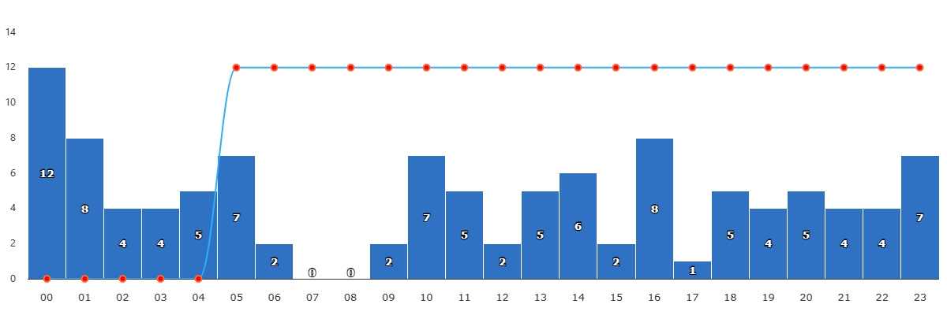
12/09/2025
SPZO
BAJA
VMC
IMC/MET adversa
Majo mínimos / Cerrado
TAF SPZO 111700Z 1118/1218 03013KT 9999 SCT050 TX22/1119Z TN05/1211Z TEMPO 1118/1121 02015G25KT BECMG 1123/1124 08003KTTAF SPZO 111700Z 1118/1218 03013KT 9999 SCT050 TX22/1119Z TN05/1211Z TEMPO 1118/1121 02015G25KT BECMG 1123/1124 08003KT=TAF SPZO 111700Z 1118/1218 03013KT 9999 SCT050 TX22/1119Z TN05/1211Z TEMPO 1118/1121 02015G25KT BECMG 1123/1124 08003KT=

Slide 4
12/09/2025
SPJC
BAJA
VMC
IMC/MET adversa
Majo mínimos / Cerrado
TAF SPJC 111700Z 1118/1218 23010KT 8000 SCT013 OVC022 TX19/1119Z TN15/1211Z BECMG 1200/1203 15004KT FEW007 OVC014 TEMPO 1208/1211 4500 DZ BR SCT005 OVC009 BECMG 1213/1215 23010KT FEW011 OVC017TAF SPJC 111700Z 1118/1218 23010KT 8000 SCT013 OVC022 TX19/1119Z TN15/1211Z BECMG 1200/1203 15004KT FEW007 OVC014 TEMPO 1208/1211 4500 DZ BR SCT005 OVC009 BECMG 1213/1215 23010KT FEW011 OVC017=TAF SPJC 111700Z 1118/1218 23010KT 8000 SCT013 OVC022 TX19/1119Z TN15/1211Z BECMG 1200/1203 15004KT FEW007 OVC014 TEMPO 1208/1211 4500 DZ BR SCT005 OVC009 BECMG 1213/1215 23010KT FEW011 OVC017=

Slide 5
12/09/2025
SPZO
BAJA
VMC
IMC/MET adversa
Majo mínimos / Cerrado
TAF SPZO 111700Z 1118/1218 03013KT 9999 SCT050 TX22/1119Z TN05/1211Z TEMPO 1118/1121 02015G25KT BECMG 1123/1124 08003KTTAF SPZO 111700Z 1118/1218 03013KT 9999 SCT050 TX22/1119Z TN05/1211Z TEMPO 1118/1121 02015G25KT BECMG 1123/1124 08003KT=TAF SPZO 111700Z 1118/1218 03013KT 9999 SCT050 TX22/1119Z TN05/1211Z TEMPO 1118/1121 02015G25KT BECMG 1123/1124 08003KT=

Slide 6
12/09/2025
SPJC
BAJA
VMC
IMC/MET adversa
Majo mínimos / Cerrado
TAF SPJC 111700Z 1118/1218 23010KT 8000 SCT013 OVC022 TX19/1119Z TN15/1211Z BECMG 1200/1203 15004KT FEW007 OVC014 TEMPO 1208/1211 4500 DZ BR SCT005 OVC009 BECMG 1213/1215 23010KT FEW011 OVC017TAF SPJC 111700Z 1118/1218 23010KT 8000 SCT013 OVC022 TX19/1119Z TN15/1211Z BECMG 1200/1203 15004KT FEW007 OVC014 TEMPO 1208/1211 4500 DZ BR SCT005 OVC009 BECMG 1213/1215 23010KT FEW011 OVC017=TAF SPJC 111700Z 1118/1218 23010KT 8000 SCT013 OVC022 TX19/1119Z TN15/1211Z BECMG 1200/1203 15004KT FEW007 OVC014 TEMPO 1208/1211 4500 DZ BR SCT005 OVC009 BECMG 1213/1215 23010KT FEW011 OVC017=

Slide 7
12/09/2025
SPZO
BAJA
VMC
IMC/MET adversa
Majo mínimos / Cerrado
TAF SPZO 111700Z 1118/1218 03013KT 9999 SCT050 TX22/1119Z TN05/1211Z TEMPO 1118/1121 02015G25KT BECMG 1123/1124 08003KTTAF SPZO 111700Z 1118/1218 03013KT 9999 SCT050 TX22/1119Z TN05/1211Z TEMPO 1118/1121 02015G25KT BECMG 1123/1124 08003KT=TAF SPZO 111700Z 1118/1218 03013KT 9999 SCT050 TX22/1119Z TN05/1211Z TEMPO 1118/1121 02015G25KT BECMG 1123/1124 08003KT=

Slide 8
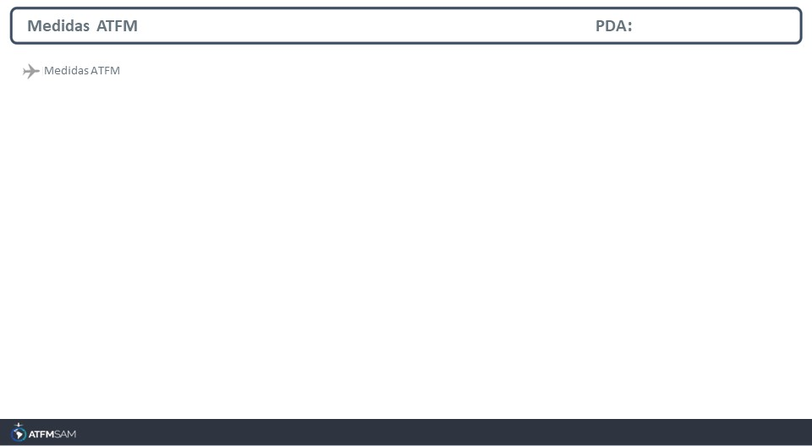
STATE | ORIGIN | DESTINY | ER | START | MEASURE | REASON

Slide 9
