Slide 1

PDA - COLOMBIA
11/09/2025

Slide 2
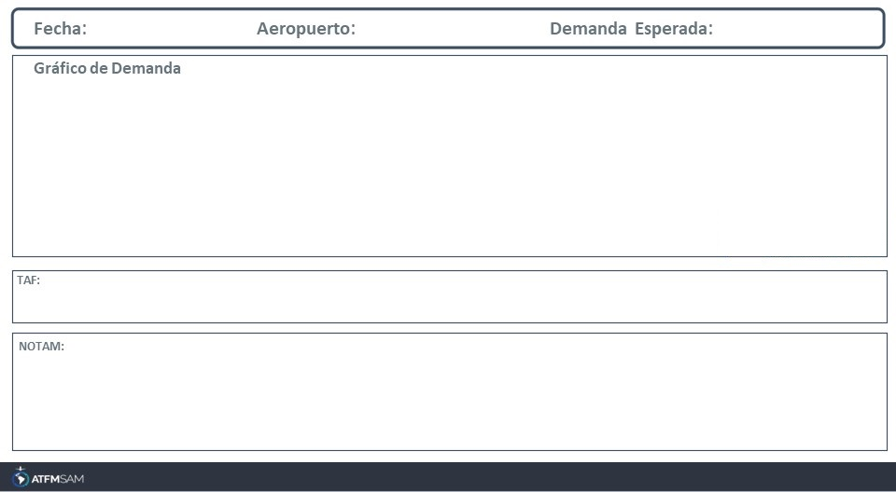
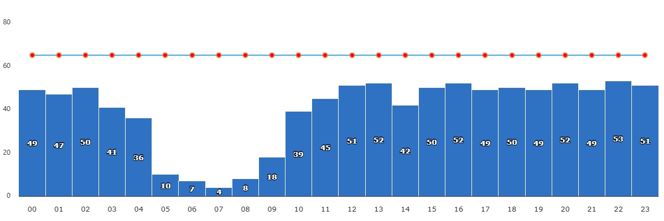
11/09/2025
SKBO
BAJA
VMC
IMC/MET adversa
Majo mínimos / Cerrado
TAF SKBO 101055Z 1012/1112 06004KT 9999 FEW015 BECMG 1015/1017 16010G21KT SCT015 TEMPO 1107/1111 BKN015 TX19/1018Z TN09/1110Z

Slide 3
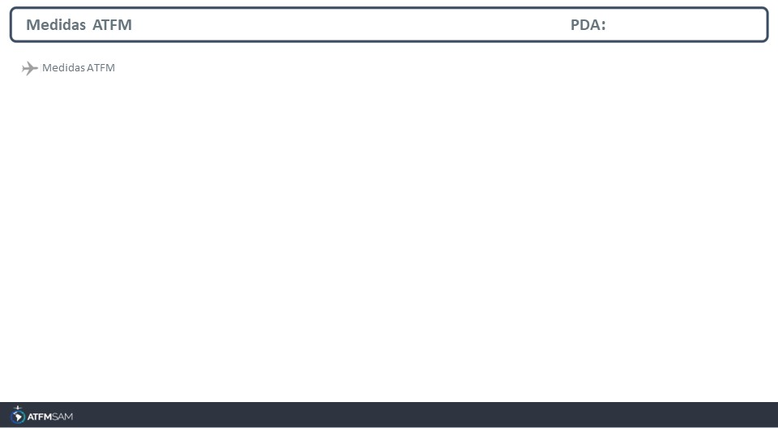
STATE | ORIGIN | DESTINY | ER | START | MEASURE | REASON

Slide 4
