Slide 1
PDA - CHILE 16/07/2025

Slide 2
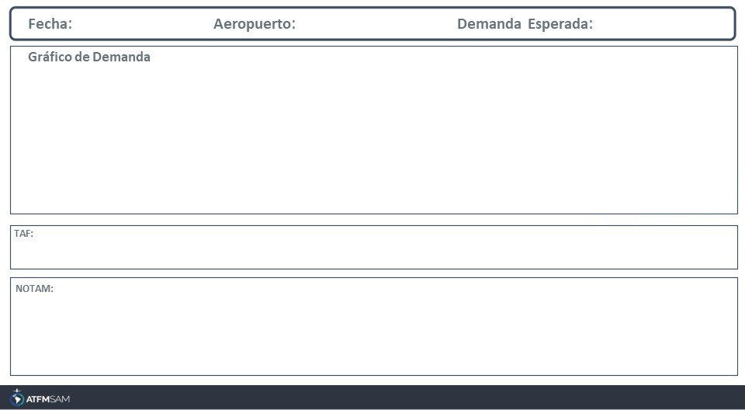
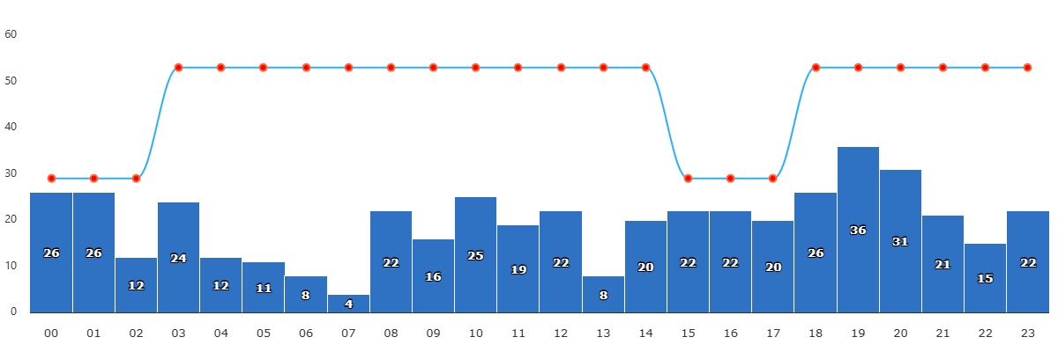
16/07/2025
SCEL
BAJA
VMC
IMC/MET adversa
Majo mínimos / Cerrado
TAF SCEL 151000Z 1512/1612 VRB02KT 0500 FG NSC TX11/1519Z TNM00/1610Z BECMG 1515/1517 3000 BR BECMG 1517/1519 18008KT 7000 NSW BECMG 1600/1602 32004KT 4000 HZ TEMPO 1606/1612 VRB02KT 2000 BR
SCEL - RWY 17L/35R CLSD EXCEPT LVP IS ACT CREATED: 02 Jul 2025 20:39:00 SOURCE: SCSCYNYX start: 2025-07-15T12:00:00.000Z - End: 2025-07-15T14:00:00.000Z SCEL - RWY 17L/35R CLSD EXCEPT LVP IS ACT CREATED: 02 Jul 2025 20:39:00 SOURCE: SCSCYNYX start: 2025-07-16T13:00:00.000Z - End: 2025-07-16T15:00:00.000Z

Slide 3
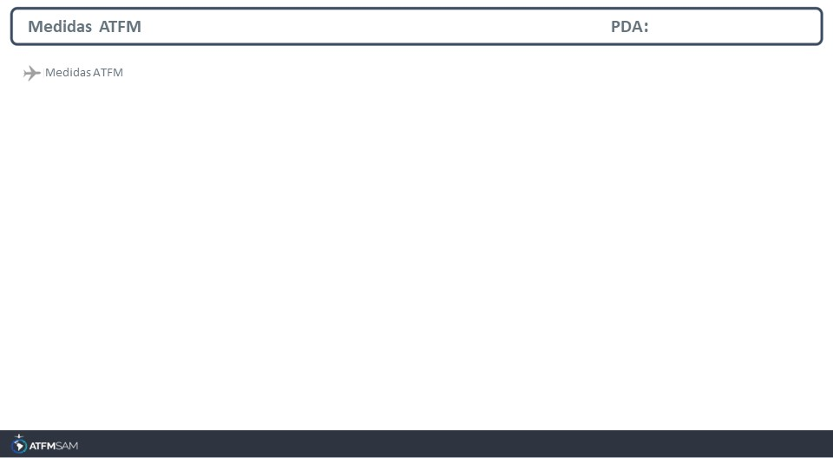
STATE | ORIGIN | DESTINY | ER | START | MEASURE | REASON
CHILE | SAMF | SCEZ | SCEZ | 16/07/2025 - 14:00 | 00:03:00 | PISTA INTERDITADA

Slide 4
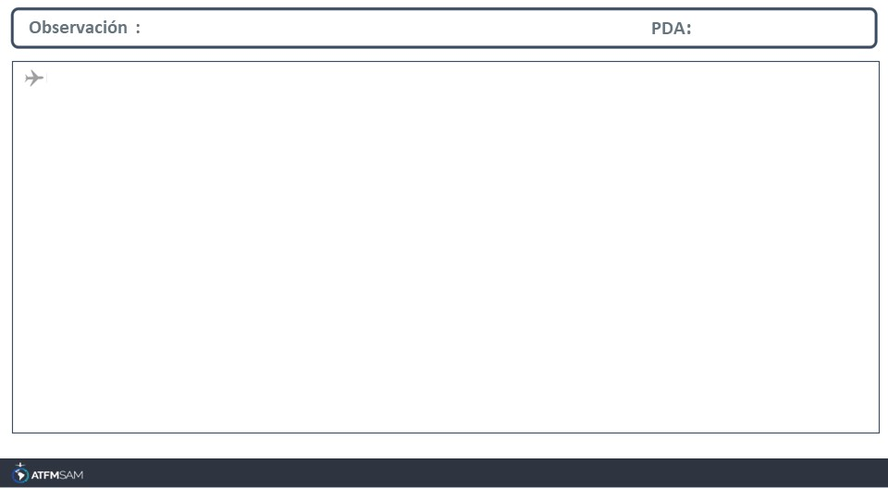
JMP

