Slide 1
PDA - BRAZIL 16/07/2025

Slide 2
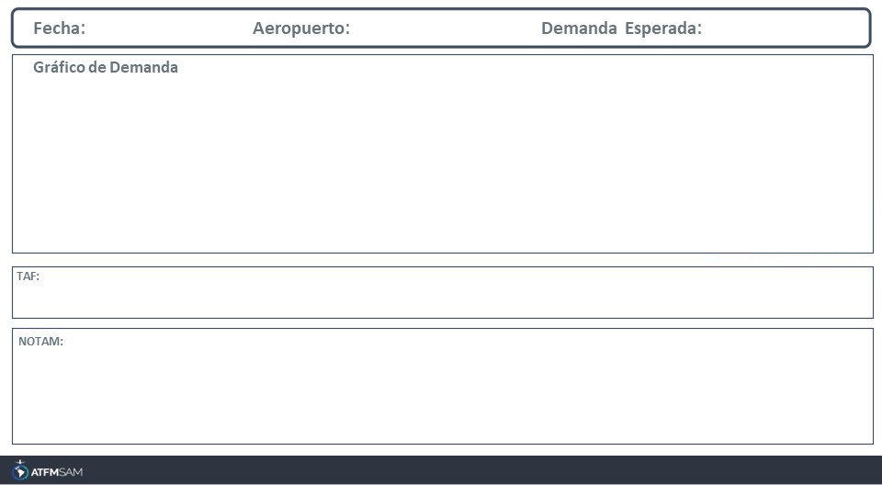
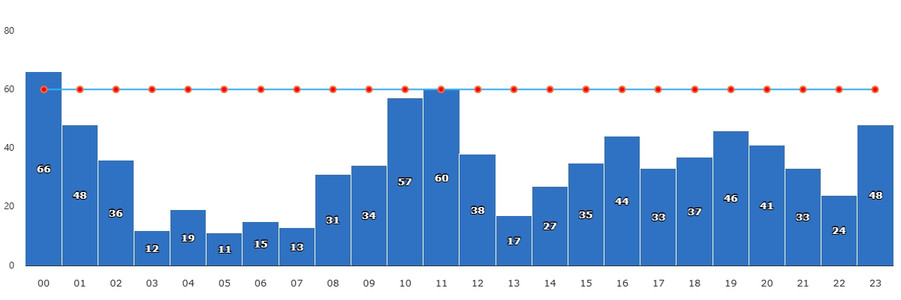
16/07/2025
SBGR
BAJA
VMC
IMC/MET adversa
Majo mínimos / Cerrado
TAF SBGR 150900Z 1512/1618 08005KT 4000 BR SCT006 TN10/1609Z TX23/1617Z BECMG 1512/1515 15005KT CAVOK BECMG 1521/1523 10005KT BECMG 1600/1603 07004KT PROB30 1607/1611 4000 BR BKN006 BECMG 1612/1615 06007KT BECMG 1616/1618 18005KT RMK PGH

Slide 3
STATE | ORIGIN | DESTINY | ER | START | MEASURE | REASON

